Slide 1
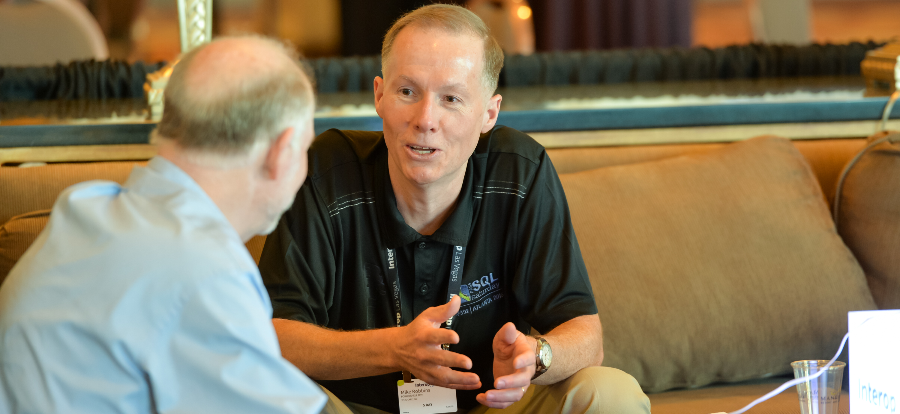


OnRamp Welcome & Intro
OnRamp Team
github.com/devops-collective-inc/OnRamp-2025/

